Slide 1

On Becoming A Leader In Risk Management
Fundamentals of RM
RM system and Process
Leadership in RM
Incident Investigation
RM Tools & Challenges
RM in Industry
People & Org.
Applications & Perspectives
ENGG404 - Lecture
Chapter 7.6: Leadership in Risk Management - Putting Theory into Practice: The Bias for Action
1
Notes:
1

Slide 2
Learning Outcomes:
Explain the bias for action, and how it relates to managing the residual risk.
Recognize when to practice a bias for action, and apply methods to have or take a bias for action.
Chapter 7.6: Bias for Action
2
Notes:
2

Slide 3
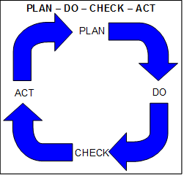
Introduction:
Recall from an earlier lecture where Plan-Do-Check-Act was introduced, and that it requires a bias for action at all four steps.
Bias for Action is:
Driven by leaders!
Is engrained in the culture of the organization.
Is relentless in nature as leaders are never satisfied with the status quo.
Leaders demonstrate ownership of PDCA through their bias for action wherein they execute all four steps of the PDCA in whatever they do.
Chapter 7.6: Bias for Action
3
Notes:
3

Slide 4
Introduction:
Bias for Action is intended to manage the residual risk to ensure:
The risk management system and elements are functioning effectively.
No management system weaknesses, no loss of control, no inadequacies, and no latent causes.
Actions are taken to address latent causes when found.
In other words, the “bias for action” ensures the risk management program is effectively (and robustly) implemented.
Leading organizations practice the bias for action at all levels on a continual basis.
Chapter 7.6: Bias for Action
4
Notes:
4

Slide 5
Introduction:
The bias for action is practiced through these three processes:
Reactively as part of incident investigations and root cause analysis at the manager’s facility
RME #5 Incident Reporting, Investigation, Analysis and Actions
This topic is well-covered in other chapters & your team project.
Proactively by learning from others
Your team project is an example of that!
Proactively through audits of the risk management program. (the Handbook may use the term “planned inspections at the organizational level”).
RME #6 Program Evaluation and Continuous Improvement
The other choices are tools, the mechanisms, that a leader applies to discover latent causes in their risk management system and program.
Chapter 7.6: Bias for Action
5
Notes:
5

Slide 6
Bias for Action and Managing the Residual Risk:
Line management (the manager) is responsible and accountable!
Context: how?
Let’s discuss the role of the Manager in the 2nd & 3rd processes:
Proactive Response to Bad News Elsewhere i.e. learn from others … any loss incident, relevant to your business, that has made the news … real people ... real impact on the environment … real impact on business interests
Proactive Response to a Formal Audit of the risk management program within your organization i.e. identify latent causes (weaknesses in the management system) in my organization before an incident occurs.
Chapter 7.6: Bias for Action
6
Notes:
6

Slide 7
2) Proactive Response to Bad News Elsewhere:
Bad news elsewhere …
The Irving Oil Refinery in St. John, New Brunswick
Bridge Failure, Genoa, Italy
Arena Refrigeration (Ammonia / Brine) System, Fernie, BC
Food Recall - Chicken Fries
Teck Elkview Mine Explosion, Elk Valley, BC
Oilfield Site, Pigeon Lake, AB
i.e. Any loss incident, relevant to your business, that has made the news … real people ... real impact on the environment … real impact on business interests
Chapter 7.6: Bias for Action
7
Notes:
7

Slide 8
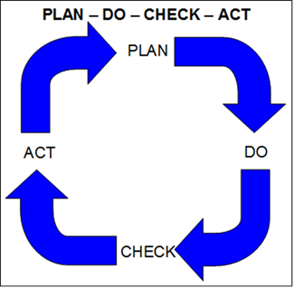
2) Proactive Response to Bad News Elsewhere:
Event in the news media.
Surmise a couple of possible causes.
Gather your team.
Conduct an investigation based on best-available information and the expertise on your team.
Determine preventative actions.
Your leader calls you, and you give her an update.
You gain her support for proceeding with actions.
Over the weeks, your team learns more, you implement the actions and you update your plans.
One month later, you reconvene your team to review and check on progress, other lessons from the event, and you update your leader.
For actions not yet undertaken or deemed not effective, your team revisits those ineffective actions to determine new and different actions.
Please take a moment to Identify the PDCA steps!
Chapter 7.6: Bias for Action
8
Notes:
8

Slide 9
2) Proactive Response to Bad News Elsewhere:
Event in the news media.
Surmise a couple of possible causes.
Gather your team.
Conduct an investigation based on best-available information and the expertise on your team.
Determine preventative actions.
Your leader calls you, and you give her an update.
You gain her support for proceeding with actions.
Over the weeks, your team learns more, you implement the actions and you update your plans.
One month later, you reconvene your team to review and check on progress, other lessons from the event, and you update your leader.
For actions not yet undertaken or deemed not effective, your team revisits those ineffective actions to determine new and different actions.
4) Plan
8) Do
9) Check
10) Act
Chapter 7.6: Bias for Action
9
Notes:
9

Slide 10
2) Proactive Response to Bad News Elsewhere:
4) Conduct an investigation
10) Your team revisits those ineffective actions …
8) Implement the actions
9) Check progress on the actions.
Chapter 7.6: Bias for Action
10
Notes:
10

Slide 11
3) Proactive Response to an External Audit at Your Plant:
Recall that the Formal Audit is a best practice.
Discussed in Chapter 3.3 RME #6 Program Evaluation & Continuous Improvement, The Formal Audit is a planned inspection at the organizational level.
Recall there are two types of Audits: Internal and External
Chapter 7.6: Bias for Action
11
Notes:
11

Slide 12
3) Proactive Response to an External Audit at Your Plant:
Consider a thorough, intensive, risk management system audit conducted by expert third-party auditors that happens once every three years …
Well prepared: Many internal audits conducted in the months prior, and weaknesses addressed in preparation for this external audit.
The auditors present their findings: a list of deficiencies (despite your best efforts) and recommendations to you, the manager of this facility.
You and your team finalize an action plan, assign owners & due dates.
Monthly, progress is checked. No surprises!
You periodically update your leader.
You move on with successes:
No loss incidents.
You applied your best efforts to ensure your people worked safety in a safe workplace.
You have left behind an improved the workplace. .
Chapter 7.6: Bias for Action
12
Notes:
12

Slide 13
Managers and the Follow-up:
Line management is responsible and accountable!
Managers must:
For Incident Investigations:
Conduct root cause analysis, drill down to latent causes to make SMART recommendations, and implement those recommendations.
For Audits:
Have good breadth that looks across all parts of the organization and all parts of the RM system & program.
Good depth that examines from “policy level” down through to execution i.e. the work practices.
Represents a good sample of the facility activities.
Implement SMART recommendations to address deficiencies.
For the identified SMART actions:
Drive the organization to complete the actions.
Check the effectiveness of those actions.
Chapter 7.6: Bias for Action
13
Notes:
13

Slide 14
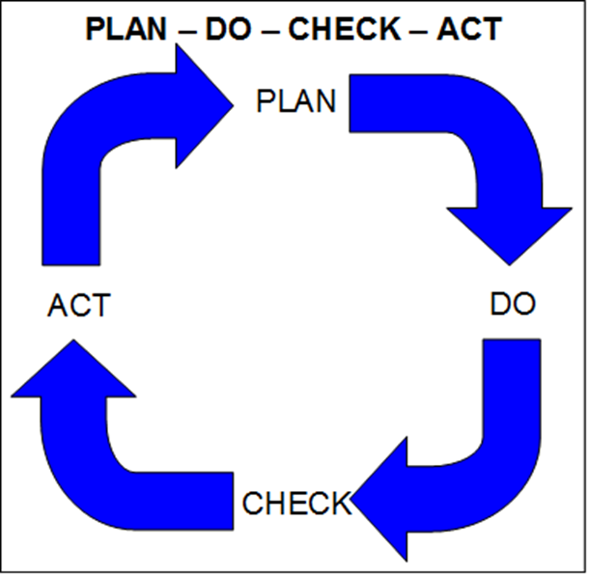
Summary and Key Lesson:
The Bias for Action is practiced using three process:
Incident investigations – reactive response
Learning from others – proactive response to bad news elsewhere
Audits of the risk management program – proactive
Managers must drive the PDCA cycle.
Must take action to eliminate latent causes when found.
The “bias for action” ensures the risk management program is effectively (and robustly) implemented.
Key Lesson: The best managers have a bias for action on all steps!
Chapter 7.6: Bias for Action
14
Notes:
14

